Slide 1
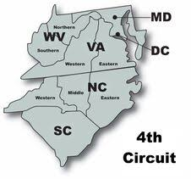
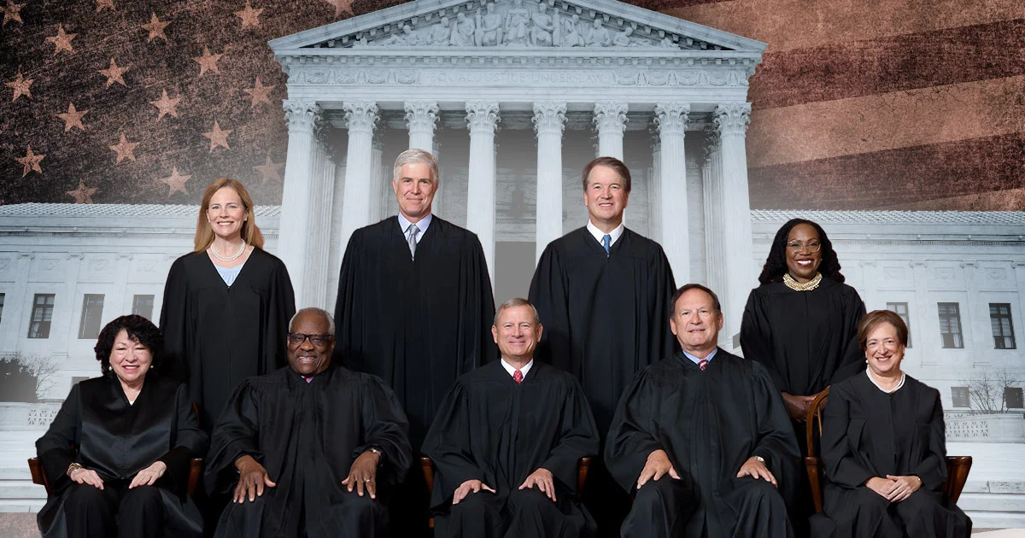
SUPREME Court and Fourth Circuit Update:
Important Recent Decisions on Criminal Law
Josh Carpenter – Appellate Chief – FPDWNC Ann Hester – Appellate AFPD –FPDWNC

Slide 2
OVERVIEW
What We’ll Cover
Two Supreme Court Fourth Amendment Cases
Second Amendment Update – both Supreme Court and Fourth Circuit
Notable Fourth Amendment Cases from the Fourth Circuit
Supervised Release & Sentencing Issues
Resources
Handout #1: Summary of Supreme Court cases decided in Oct. 2025 Term
Handout #2: Summary of Fourth Circuit cases (courtesy of Patrick Bryant, ED VA)
Fourth Circuit Blog & In Plain Cite podcast (courtesy of SD WV FPD)
SCOTUSblog
Notes:
Josh
Not trying to cover everything – looking to touch on cases most likely to arise in your cases; heavy on second amendment and fourth amendment

Slide 3
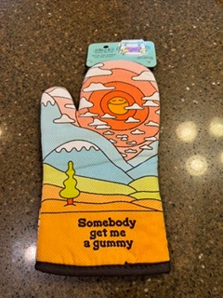
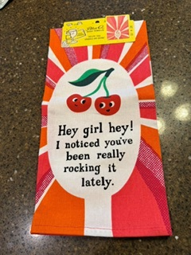

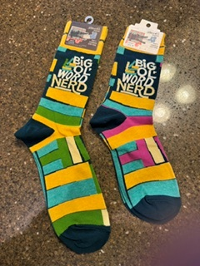
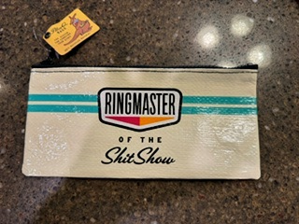
We will host three trivia breaks.
With prizes.
All Moderator decisions are final. Ironically, there will be no appeals.
Must be present to win.
Notes:
Ann

Slide 4

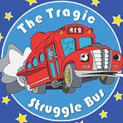
Two Observations about 2025-2026 SCOTUS Term
#1 – It’s probably not as bad as you think
#2 – The Fourth Circuit is riding the StruggleBus
Notes:
Josh Slide

Slide 5
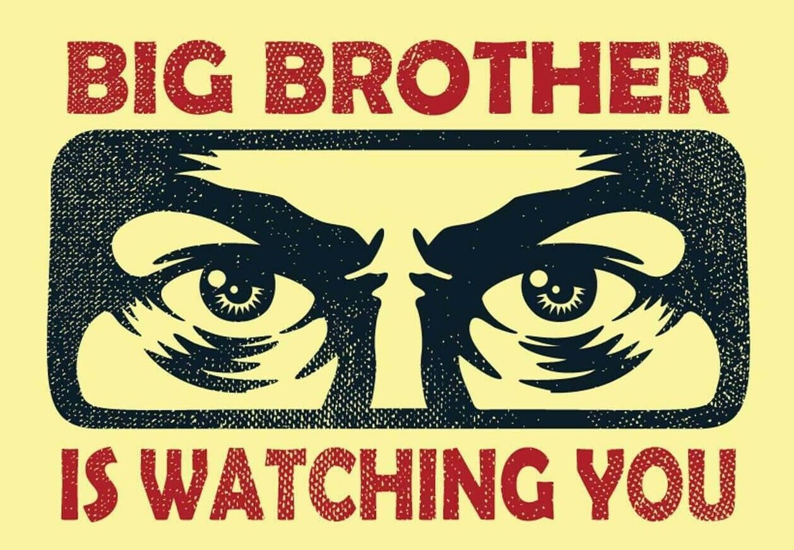
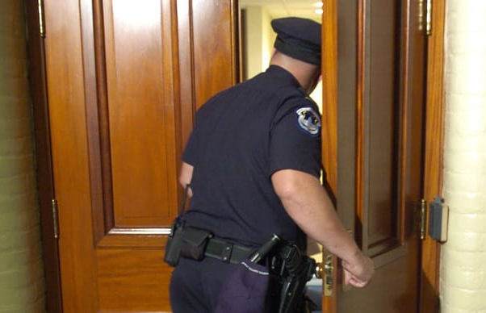
Two NEW SUPREME COURT
FOURTH AMENDMENT CASES
Chatrie v. US:
Electronic surveillance
Case v. Montana:
Emergency aid exception
Notes:
Ann
The Supreme Court issued two Fourth Amendment opinions on the merits docket this term.
Chatrie v. United States addressed whether getting geofence data from Google is a search.
Case v. Montana addressed the emergency aid exception to the warrant requirement

Slide 6


Chatrie v. United States, 146 S. Ct. 2193 (2026)
(Kagan, J.) (6-3 opinion)
Obtaining Location History data is a Fourth Amendment search.
  People have a reasonable expectation of privacy in their cell-phone location history data.
Even if search covers a short period of time.
  Expands Carpenter v. United States.
Even though data was stored with a third-party company in the cloud.
  “a cell-phone user is not to be viewed a sharing private information with third parties . . . Just by doing the ordinary things cell-phone users do.”
  Employs a two-part test instead of third-party doctrine
  Suggests other data saved in the cloud is also protected.
Notes:
Ann
Chatrie has broad implications for government surveillance.
Chatrie arose from a bank-robbery investigation where police had no suspects. They obtained a “geofence warrant” that required Google to search the Location History of literally, all Google users who had location history enabled on their phones - so law enforcement could identify devices near the crime scene. Once that huge data search identified records of 19 devices, second and third steps allowed investigators to choose what additional data to obtain about those 19 devices.
[Click]
Before Chatrie, the government was arguing based on Carpenter v. United States that location searches shorter than 7 days weren’t a fourth-amendment search at all.
In Chatrie the Court held a person’s privacy interest in their cell-phone location data exists regardless of the length of time their location is monitored, rejecting that notion that short-term location surveillance isn’t a Fourth Amendment search.
[Click}
The Court also considered the third-party doctrine, and may have killed it in the context of digital searches – this was a rule from the 1970s that people don’t have privacy in the phone numbers they dial or the checks they deposit because they voluntarily shared that information with third party phone companies and banks.
Instead of using third-party the Court employed a two-part test that considers:
(1) whether a user “reasonably understands” the data as their own, and
(2) whether a user meaningfully intended to share it as opposed to merely having it processed by a tech company.
Recognized cloud-stored data like email, photos, and calendar appointments satisfy this test.
And location data does, too.

Slide 7
Chatrie has implications for other digital searches. Challenge them.
Tower dumps: seek identity of every device connected to specific cell towers over a relatively short period of time.
  US District court held tower dumps per se unconstitutional general warrants: In re Four Applications for Search Warrants Seeking Info. Associated with Particular Cellular Towers, No. 3:25-CR-38 (S.D. Miss. Aug. 5, 2026).
Cell Site Simulators (Stingrays): simulating a cell tower to trick nearby cell phones to connect, used to locate and track a known cell phone or obtain a person’s phone number when it is unknown.
Automatic License Plate Readers (ALPRs) (Flock): can be used recreate the whole of a person’s past movements.
Keyword warrants/ AI chats: seek identity of everyone who searched for a particular keyword or phrase.
Notes:
Ann
You probably won’t see any geofence warrants, because Google doesn’t store people’s location data centrally any more, and none of the other tech companies ever cooperated. But Chatrie has implications for other types of digital surveillance.
I highly recommend reading the Mississippi district court’s opinion denying a tower-dump warrant application and holding it’s per se unconstitutional. It is thorough. It can provide you with the framework for making similar arguments
[Click]
Here are a few additional types of surveillance that might be affected by Chatrie: stingrays, license plate readers and keyword warrants.
The NACDL Fourth Amendment Center is a good resource if you encounter one of these searches.

Slide 8
If you have a case involving any of these types of searches:
NACDL’s Fourth Amendment Center is a great resource and offers direct assistance.
  Email: 4AC@nacdl.org.
  Website: https://www.nacdl.org/Landing/FourthAmendmentCenter
Chatrie practice advisory for more detail:
  https://www.nacdl.org/Document/Practice-Advisory-Chatrie-v-United-States,-What-De
For a deep dive into the future implications of Chatrie:
  Orin S. Kerr, The Fourth Amendment After Chatrie (still in draft form)
Notes:
Ann

Slide 9

Chatrie still isn’t over….
Remanded to Fourth Circuit to decide:
  Whether the warrant satisfied the Fourth Amendment’s probable cause and particularity requirements.
  Whether the good-faith exception applies.
Notes:
Ann
Chatrie has been pending for 7 years, and it still isn’t over.
The Supreme Court remanded it to the 4th Circuit to decide:
[click} whether the warrant satisfied probable cause and particularity requirements and
[click] whether the good-faith exceptionapplies.
The good-faith exception prevents a person from getting relief if police relied on existing precedent at the time of the search. It’s possible Chatrie won’t be able to benefit from his own litigation.

Slide 10

Case v. Montana, 146 S. Ct. 500 (2026)
(Kagan, J.) (9-0)
Emergency-aid exception
Police may enter a home without a warrant if they have an “objectively reasonable basis for believing” that someone inside needs emergency assistance. Brigham City v. Stuart, 547 U.S. 398 (2006)
“Objectively reasonable basis for believing” isn’t probable cause.
It isn’t Terry reasonable-suspicion, either.
Evaluated under totality of the circumstances.
Important limitation: Officers can’s search “beyond what is reasonably needed to deal with the emergency while maintaining the officers’ safety.”
Notes:
Ann
Talk from slide for 1st 2 clicks
Takeaway is – if you get one of these cases You’ll need to compare emergency-aid cases to other emergency-aid cases.
[click] Like everything that requires reasonableness review, it depends on the totality of the circumstances
[click]A warrant is required to search beyond what’s needed to render emergency aid and keep officers safe.

Slide 11
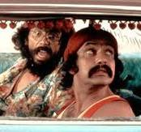
Trivia challenge #1!
Which Justice during the past Supreme Court Term mused:
“Or does he use a mild gummy as a sleep aid a few times a week?”
Justice Thomas
Justice Gorsuch
Justice Sotomayor
Justice Kagan
Notes:
Josh

Slide 12
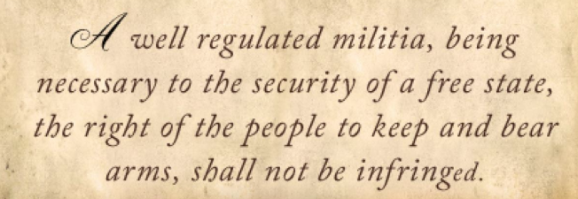
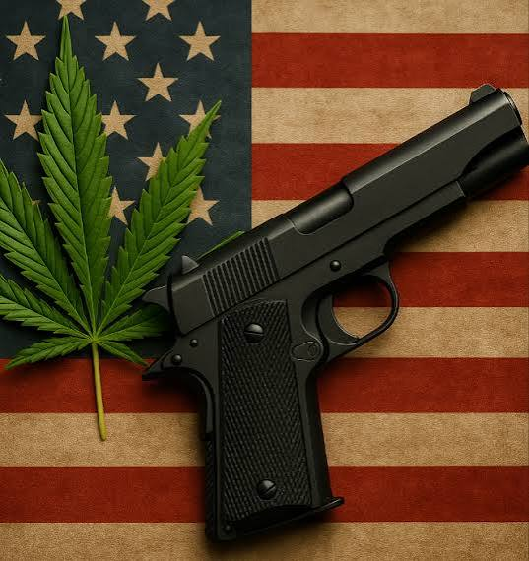
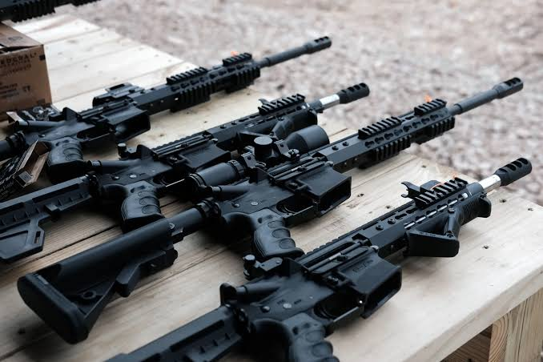
The Second Amendment
Notes:
Josh
Bruen – now four years old; lots of litigation since then, both on the civil and criminal front – as an example of that – 8 published opinions on 2A issue in the Fourth Circuit in the past year; when thinking about these issues, it’s important to separate out how the Fourth Circuit views the Second Amendment from how the Supreme Court does

Slide 13
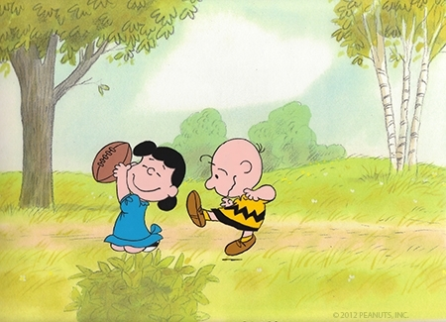
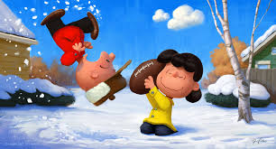
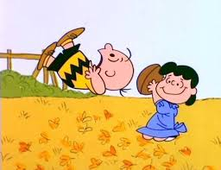
Second Amendment Developments in The Fourth Circuit
Notes:
Josh
Sometimes a picture is worth a thousand words

Slide 14

Second Amendment Developments in The Fourth Circuit
12 published criminal opinions addressing 2A issues
75 unpublished criminal opinions on 2A issues
Defendants have compiled a total of ZERO wins
Similar results in civil cases: only one partial win for a 2A challenge
Notes:
These numbers are post-Bruen.

Slide 15

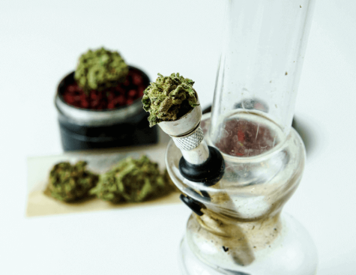
United States v. Hemani (June 18, 2026) (9-0)
Hemani: admitted using marijuana “about every other day”
922(g)(3): “an unlawful user of or addicted to any controlled substance”
Gov’t Theory: (g)(3) = founding-era “habitual drunkard” laws
Holding: violates Second Amendment as applied because “habitual drunkard” laws are not sufficiently analogous
Notes:
Josh
Backstory – terrorism investigation; search warrant – found weed and cocaine; admitted weed use, said he’d stopped using cocaine;
Drunkard analogy – required significant incapacitation, not just use or even excessive use; lots of fun quotes about how drunk all the founding fathers were
Holding – key was breadth of gov’t theory; opinion held it would sweep in someone who uses a “mild gummy” as sleep aid or a college student who used Adderall to cram for exams

Slide 16

Hemani: Open Questions
Majority says “narrow” holding that doesn’t address:
    “those presently intoxicated”
    “individualized proof” that use renders person “a danger to himself or others”
    “proof that a certain drug always renders its users dangerous”
Opinion does not mention statutory issues / vagueness challenges
Notes:
Josh
Does not address whether these extra-statutory findings, if sufficient, would be treated as an element of the offense to go to jury or as legal question to be resolved by judge.
Bottom line – unclear whether prosecutors will continue trying to use (g)(3); if they do, there is plenty to litigate

Slide 17
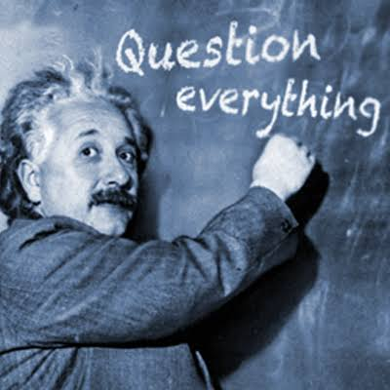
Hemani: Thomas Concurrence
Commerce Clause:
  “922(g)(3) appears to exceed Congress’s enumerated power to regulate interstate commerce”
  This theory could invalidate ALL of 922(g)
US v. Squire (CA5) (en banc review ordered July 20, 2026)
Notes:
Josh
Thomas writes separately “to call attention” to a potential Commerce Clause

Slide 18
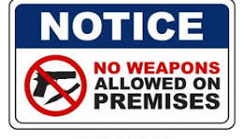
Other SCOTUS Developments on Second Amendment
Wolford v. Hawaii:
  6-3 win for Second Amendment challenge to Hawaii law setting default no-guns rule for private property open to the public
  Consistent with Kipke v. Moore (CA4 Jan. 20, 2026)
Cert Grant in Viramontes v. Cook County
  Issue: Validity of state-level assault weapons bans as applied to semi-automatic rifles like the AR-15
Notes:
Josh
Conflict between property rights and the second amendment

Slide 19
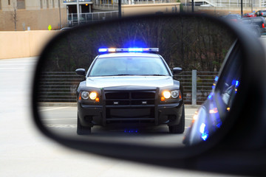
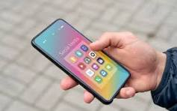

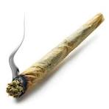

FOURTH AMENDMENT DEVELOPMENTS
IN THE FOURTH CIRCUIT
Notes:
Ann

Slide 20

Let’s talk about sakyi
United States v. Sakyi, 160 F.3d 164 (4th Cir. 1998): allows officers to order everyone out of a vehicle and pat them down based on reasonable suspicion marijuana is present.
Sakyi says it creates a presumption, but in practice it’s a per se rule.
Sakyi is based on the idea that marijuana = guns = danger
Notes:
Ann
Sakyi is a terrible decision – it allows officers to pull everyone out of the car and frisk them during a traffic stop based on reasonable suspicion weed is present.
Normally a Terry frisk requires reasonable suspicion of a crime PLUS reasonable suspicion that a person is armed and dangerous.
[click] Sakyi created what has in practice become a per se rule of dangerousness for purposes of a Terry frisk.
It was wrong from the beginning because it established a bright-line rule instead of evaluating the totality of the circumstances
But even if it were correct when it was decided, it just makes no sense any more in light of how easy it is to get marijuana legally.
[click]
It’s based on the idea that people who possess marijuana are inherently dangerous because drugs and guns go together.
We’ve challenged it in the past and failed to get any traction, but Hemani may have breathed some new life into efforts to get rid of it.

Slide 21
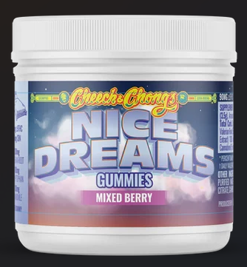
Hemani may help
Supreme Court rejected the idea that regularly using marijuana made Hemani too dangerous to possess a gun.
Hemani explains there’s a disconnect between federal marijuana policy and the idea that marijuana users are “categorically and unusually dangerous.”
This is obviously in tension with Sakyi.
Judge Berner’s concurrence in United States v. Carson, 180 F.4th 650 (4th Cir. 2026), cites Hemani, says:
  Sakyi “can no longer hold water in this era of widespread marijuana legalization.”
Notes:
Ann
[click]
Hemani acknowledges marijuana use is broadly legal and people use it more than alcohol, which makes it difficult to say people who use it are categorically dangerous.
This is obviously in tension with Sakyi.
[Click]
Judge Berner’s recent concurrence in US v. Carson acknowledges this tension, but it will take an en banc decision to overrule Sakyi.
Melissa Baldwin from our office is filing an en banc petition in Carson, so stay tuned on that.
If you see this fact pattern – occupants of a vehicle being patted down because officers suspect marijuana – challenge it and appeal it.

Slide 22

First, the good news!
Notes:
Ann
[Click] On to the recent Fourth Am cases – this has been a good year in the Fourth Circuit for the Fourth Amendment. We have FOUR victories to discuss.

Slide 23

Trivia challenge #2!
Which Fourth Circuit judge has authored the most Fourth Amendment decisions ruling for defendants in the past year?
Judge Wilkinson
Judge Benjamin
Judge Richardson
Judge Berner
Notes:
Ann
But first, trivia!

Slide 24
United States v. Hawkins, 161 F.4th 242 (4th Cir. 2025) (Benjamin, J.)
Pretext traffic stop, really for drugs.
Held: Officers unlawfully extended the stop w/o reasonable suspicion.
Prior drug convictions and federal supervised release get “little weight” in totality of circumstances.
Officers’ “I know it when I see it”/ “knowledge and experience” testimony doesn’t cut it when the didn’t see anything passed hand-to-hand.
Notes:
Ann
Hawkins is a case with a fact pattern we see over and over again: officers were patrolling a high-crime area and saw what they *thought* was a drug transaction. They saw a pedestrian and a driver with known drug convictions interacting. But they didn’t see anything change hands and didn’t see the pedestrian walk away in possession of anything.
They followed the car, stopped it for a violation of the vehicle code, and immediately launched a drug investigation.
[Click] The Court said they didn’t have reasonable suspicion justifying that extension of the stop.
A couple of points from Hawkins may be helpful in some of your cases.
[Click] First, the Court gave little weight to criminal history, even though one of the men was still on supervised release for a federal drug offense.
[Click] Second, the Court repeated what Judge Wynn had said in his concurrence in Drakeford, which was basically to discount officers’ testimony that something is a drug deal based on knowledge and experience, even though they didn’t see anything change hands. “I know it when I see it” testimony by police deserves little weight.

Slide 25
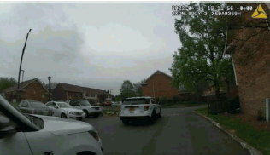
United States v. Williams, 180 F.4th 613 (4th Cir. 2026) (Benjamin, J.)
Questions were:
  when was the defendant seized, and
  did police have reasonable suspicion at that point.
  We needed the seizure to occur at the moment the police car stopped in front of Williams’s car, because the officer testified he smelled weed as soon as he got out of his car.
Held: Defendant was seized even if not fully blocked; reasonable person wouldn’t have felt free to leave.
And anonymous 911 call didn’t create reasonable suspicion.
Relies on other defense wins to find no reasonable suspicion
Notes:
Ann
Ashley Askari and I represented Mr. Williams.
In this case, officers responding to an anonymous 911 call stopped right in front of Mr. Williams’s car in an apartment parking lot while he was sitting in it. The 911 caller stated people in a white Mercedes were “possibly” selling drugs.
There are a number of things about this opinion worth discussing.
Let’s start with the holding [Click through the question and the holdings, everything but the last point]
This decision pushes the line a bit in our favor on when a seizure occurs when police park their vehicles in a way that makes it unlikely a person will feel free to leave. Police like to intimidate people into staying put while at the same time making it look like the person isn’t seized, and this case makes it a little harder.
Second, the court rejected the government’s argument that the caller’s use of the 911 system *automatically* made the tip reliable under Navarette v. California. More evidence of reliability is required than the 911 call alone.
{Click to car photo and arrow]
Third, another lesson from this case is when you have helpful video footage, use screen shots in your motion and brief. Don’t overuse them; only use screen shots that help make your point. But a good screen shot can help you make your case.
[Click] that’s Mr. Williams’s car. This is the first time I’ve seen the Court use screen shots in a 4th Am opinion: five of them. The dissent uses them, too.
Fourth, the court did its own research in the Edmunds automotive database about the relative size of certain cars and included that in the opinion. So don’t be afraid to cite to the internet and ask the court to take judicial notice of that information. The Supreme Court does it freely, the Court of Appeals does it, and so can you.
[Click to last point about Drakeford, etc.]
Finally, note that Judge Benjamin uses defense wins in Drakeford, Bowman, and Hawkins as support for finding no reasonable suspicion here. Use all of these defense wins to argue that there’s no reasonable suspicion in your case, either. The wins are piling up.

Slide 26

United States v. Martin, 173 F.4th 110 (4th Cir. 2026) (Benjamin, J.)
Officer impermissibly prolonged the traffic stop without reasonable suspicion by asking driver and passenger about the presence of guns.
Shows a detour for any length establishes a Rodriguez violation.
  Officers can ask these questions if they do so without prolonging the stop.
Whether officer can prolong stop to ask about weapons depends on the totality of the circumstances.
  Rejects per se rule that officers can ask about weapons for safety reasons
Notes:
Ann
In Martin, Park ranger in national forest stopped a couple for being parked in the middle of a one-lane bridge. The couple drove off the bridge, pulled over, and got out of the car. The ranger immediately questioned each of them about the presence of any firearms in the car. It turned out the passenger was a felon, and he was eventually charged with firearm by a felon.
Go to slide-
Court held asking about weapons unlawfully prolonged the traffic stop without reasonable suspicion.
[Click] a detour for any length of time establishes a 4th Am violation, but officers CAN ask these questions if they do it without prolonging the stop.
[Click] There is a circuit split on whether a per se rule permitting officers to ask about weapons during a traffic stop is consistent with the Fourth Amendment.
Luckily for us, the Fourth Circuit is on the correct side of that split. It depends on the totality of the circumstances here.

Slide 27
United States v. Ray, 141 F.4th 129 (4th Cir. 2025) (Thacker, J.)
Naval investigator searched defendant’s phone even though warrant only allowed seizure.
Government lost, appealed to the 4th Cir. arguing good-faith exception applies.
Good faith requires a defective warrant. This warrant wasn’t defective.
“A lack of competence . . . Cannot be converted into good faith.”
Notes:
Ann
I’ve included this fourth win simply to leave no wins uncelebrated.
I also love that the government appealed and lost.
Short and sweet- the good faith exception to the exclusionary rule doesn’t apply if the warrant isn’t defective.
This investigator just screwed up by not reading her own warrant before conducting the search.

Slide 28

Now for the bad news….
Notes:
Ann
And now for the bad news – three Fourth Amendment losses.

Slide 29
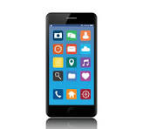
United States v. Belmonte Cardozo, 181 F.4th 461 (4th Cir. Jul. 13, 2026) (Quattlebaum, J.)
Cell-phone border searches
Existing rule: Forensic searches are nonroutine and require individualized suspicion.
This case: Manual searches are routine and don’t require individualized suspicion.
Proviso: if a manual search takes too long, Fourth Amendment may come into play.
Notes:
Ann
In Belmonte Cardozo, the court addressed manual searches of cell phones at the border, which was a novel issue in this Circuit.
[click] Existing rule – slide
[click] This case - slide
[click] But some manual searches might require more, if they take too long.
Maybe keep this in mind when deciding what devices and data you want to bring with you during international travel. Good reason to leave work at home.

Slide 30

United States v. Johnson, 148 F.4th 287 (4th Cir. 2025) (Harris, J.)
K-9 sniff next to defendant’s door in apartment hallway wasn’t a search.
No reasonable expectation of privacy because the dog could only detect contraband.
Johnson had no curtilage outside his apartment door because that area was part of a common hallway.
Deciding what is curtilage requires a fact-based analysis. Some apartments have curtilage.
Notes:
Ann
In Johnson, Law enforcement investigated a suspected drug trafficker by conducting a warrantless dog sniff outside his apartment’s front door, in the interior hallway of a large apartment building. The dog alerted, and police got a warrant to search the apartment where they found drugs and guns.
Johnson made two arguments that this was a Fourth Amendment search: a reasonable expectation of privacy argument, and a physical trespass argument. Both failed.
Go to slide-

Slide 31

United States v. Lowers, 170 F.4th 134 (4th Cir. 2025) (Thacker, J.)
Defendant had reasonable expectation of privacy in files stored in Google Drive:
  Google drive is like a filing cabinet.
  Digital files are like sealed manila envelopes—a container.
Container searches require a warrant, and so did this one.
Hash-matching digital files doesn’t support private search doctrine. A visual inspection is required.
Lowers loses because of attenuation exception to the exclusionary rule.
Notes:
Ann
Lowers is a CSAM case, and the analysis is pretty meaty. I’ll do my best to do it justice, but there are some nuggets in the opinion that I’m not going to address. Just read it.
Lowers got in trouble by downloading CSAM files to a google drive account. Google scanned the files and identified 156 files matching hash values of known CSAM. A Google employee opened 31 of the 156 files to confirm they were CSAM, then submitted the files to the National Center for Missing and Exploited Children. A NCMEC employee then viewed the same 31 files that the Google Reviewer had viewed and forwarded the tip to law enforcement.
But when police got the files, they reviewed 3 files that neither Google nor NCMEC had ever opened or viewed, and they did that without a warrant. That was a 4th Am violation.
The Court reasoned that because Google Drive is like a digital filing cabinet, A person maintains a reasonable expectation of privacy in files stored there, despite knowing that Google may scan for hash values.
It compared a digital file to a container, and reasoned the Supreme Court requires warrants to search containers. [click]. So a warrant was required.
You might think – hey, this sounds a lot like Chatrie. And it does. This decision came out before Chatrie, but it’s consistent with Chatrie’s reasoning.
[Click]
(3)The government argued the private search doctrine saved the search. That doctrine provides that when a non-governmental agent has already invaded someone’s privacy, a reasonable expectation is lost.
The Court held hash-tag matching alone doesn’t support the private search doctrine because it doesn’t actually open the files. There’s a circuit split on this issue, but once again, the Fourth Circuit is on the correct side of the split.
[Click]
(4) But alas, Lowers loses anyway under the attenuation doctrine because he consented to a bunch of searches months later and made incriminating statements to police.

Slide 32
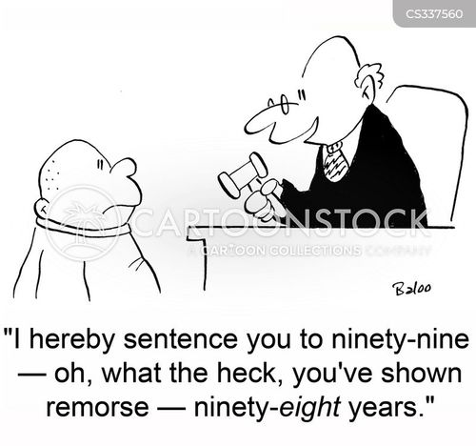
Sentencing, Supervision, and Other Issues

Slide 33
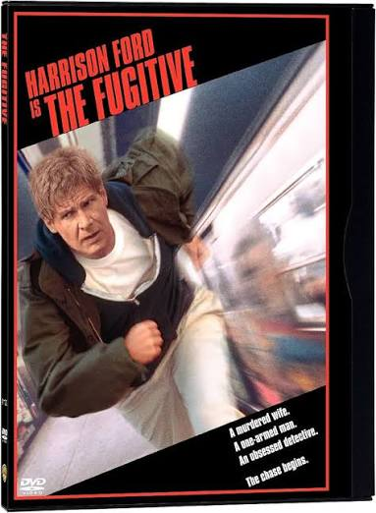
Rico v. United States (SCOTUS March 25, 2026)
Holding: Absconding does not extend or toll the term of supervised release.
  Overruling US v. Buchanan, 638 F.3d 448 (CA4 2011), which applied the fugitive tolling doctrine
Textualism for the Win: Statute has other provisions to toll or extend an SR term, but none of those address absconding.

Slide 34
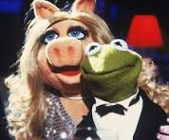
TRIVIA CHALLENGE #3!
The Supreme Court’s odd couple—Justices Alito and Kagan—filed a joint separate concurrence in Hemani. One commentator (h/t Advisory Opinions) has compared that opinion to which famous duo:
A. Turner & Hooch
B. Bonnie & Clyde
C. Kermit & Miss Piggy
D. Cheech & Chong
Notes:
Josh
After Bruen, Hawaii passed a law providing that

Slide 35
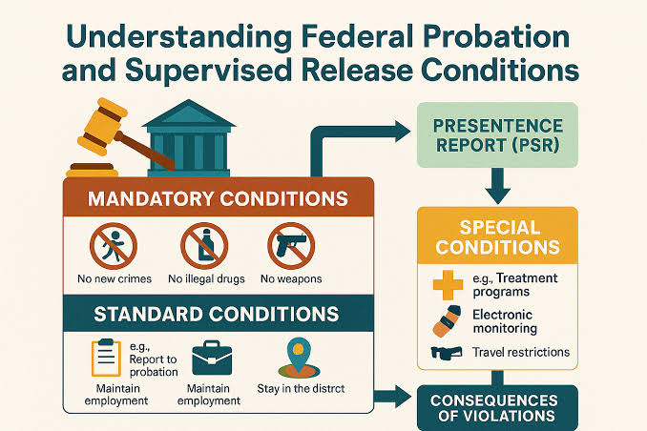
Fourth Circuit SRV Decisions
United States v. McLaurin, 168 F.4th 693 (CA4 2026)
  Holding: If a discretionary SR condition is included in the judgment—but was not orally announced—that condition is a “nullity” and cannot be used as the basis for a future violation.
United States v. Jones, 173 F.4th 87 (CA4 2026)
  Holding: Violation of a drug-testing condition via a positive drug test is a Grade C – not a Grade B – violation.
Notes:
McLaurin – practical point – if charged with violating a discretionary condition, you’ll want to look not only at the judgment but also at the transcript of the prior sentencing.

Slide 36
Sentencing: Commentary Challenges
Refresher: When the commentary is worse for the a than the text, defendants have argued – sometimes with success – that the courts must follow the text rather than the commentary.
    Most prominent example: “attempt” offenses under career-offender guideline in commentary until 2023 (Amendment 822)
United States v. Hodges, 171 F.4th 291 (CA4 2026)
  Commentary defines “minor” in CP guideline to include fictional minors
United States v. Holman, 171 F.4th 303 (CA4 2026)
  Commentary defines “large capacity” in gun guideline as “more than 15 rounds”

Slide 37
Commentary Cert Grant: Beaird v. United States
Question Presented: “Whether Stinson v. United States , 508 U. S. 36 (1993), still correctly states the rule for the deference that courts must give the commentary to the Sentencing Guidelines.”
Solicitor General: concedes that a remand is necessary because CA5 didn’t apply Kisor
Defendant’s position:
  No deference to commentary; courts must independently resolve questions of law without deference to agency interpretations, as held in Loper Bright.
  If the guidelines text is “genuinely ambiguous”—as necessary under the Kisor analysis—that text should be construed in favor of criminal defendant under the rule of lenity.
Notes:
Same issue as Holman (large capacity)
Court unlikely to reach that issue because the issue is limited to the deference standard

Slide 38
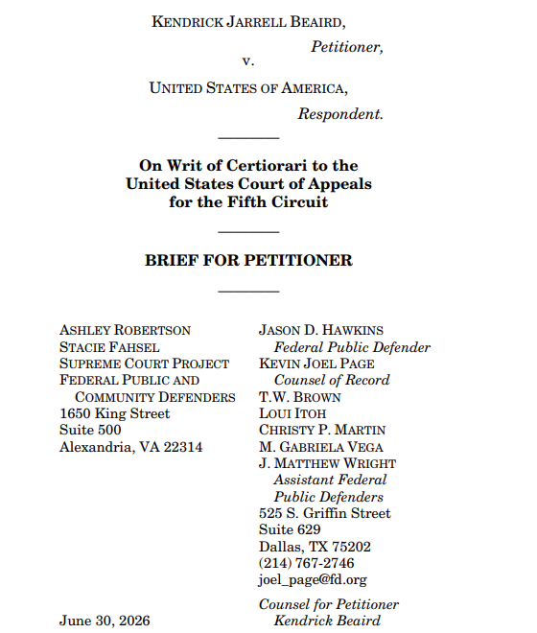

Supreme Court Project
Launched May 2026
Available as a resource for both FPD and CJA counsel
scp_inquiries@fd.org
Ashley_Robertson@fd.org
Stacie_Fahsel@fd.org
Notes:
Josh

Slide 39
